Slide 1



Airline Product Management Working Group
From Model to shared Product
Objectives, Requirements and Key Success Factors
Call 25/05/2023 / G. Baues AirFrance/KLM

Slide 2
Table of contents
01
02
03
04
05
06
Introduction
Objectives
Meta
Seat
Outlook
Proposal

Slide 3
Introduction
The airline industry is shifting to a modern retailing environment and setup which entails fundamental changes in how we organize B2B relations in our industry and beyond.
As Airlines we want to be able to share and consume, within a given framework, each others’ products in order to respond with the best possible offer to our customers
As Airlines we want to be able to integrate content from suppliers outside of our industry transparently within our offers

Slide 4
Objectives
Specify << Product Management >> related Business Capabilities and Requirements and base Principles
List add here some Key Principles / Requirements
Plus user stories

Slide 5
Utterly incomplete list of user stories
As an/a <Role> | I want | so that | Theme
Airline - Retailer | the latest up to date detailed product information available from my suppliers ( shape / form / conditions / ... full list to be determined ) | I can propose the most relevant and accurate offers to my customers and have my offer engine use the avaialble data without any restriction | User Experience / Inspiration / Aquisition #existing products
Airline - Retailer | to propose the best shopping expirience to my customers | Customers can easily find detailed product information about each product, including specifications, features, and benefits. This can help anyone to make an informed purchasing decision.
Customer | to do easy multi criteria search based shopping. Text based search would be perfect | I get the most relevant offers rapidly
Airline - Retailer | upto date information about product delivery for orders i placed with my supplier | I can react accordingly in case of issues with the delivery
Airline - Retailer | to be able to transparently exchange product configuration information with the supplier and vice versa | to honor specific agreement / products as define in the mutual agreements | #new products #extensibility
Airline - Retailer | to be in control of the information provided by a supplier catalog | only the important / pertinent information is present for creating offers thus optimizing my ressource consumption | #extensibility #optional/mandatory #schema repository / management
Airline - Supplier | to provide the most upto date and complete product information to my retailers within an bilaterally agreed scope | the call rate for offers will be optimized and therefore the conversion rate shall increase | #Traffic #Conversion

Slide 6
All of the above, as a common denominator, requires an unambiguous and extensible model allowing to describe the meaning of the products exchanged.

Slide 7
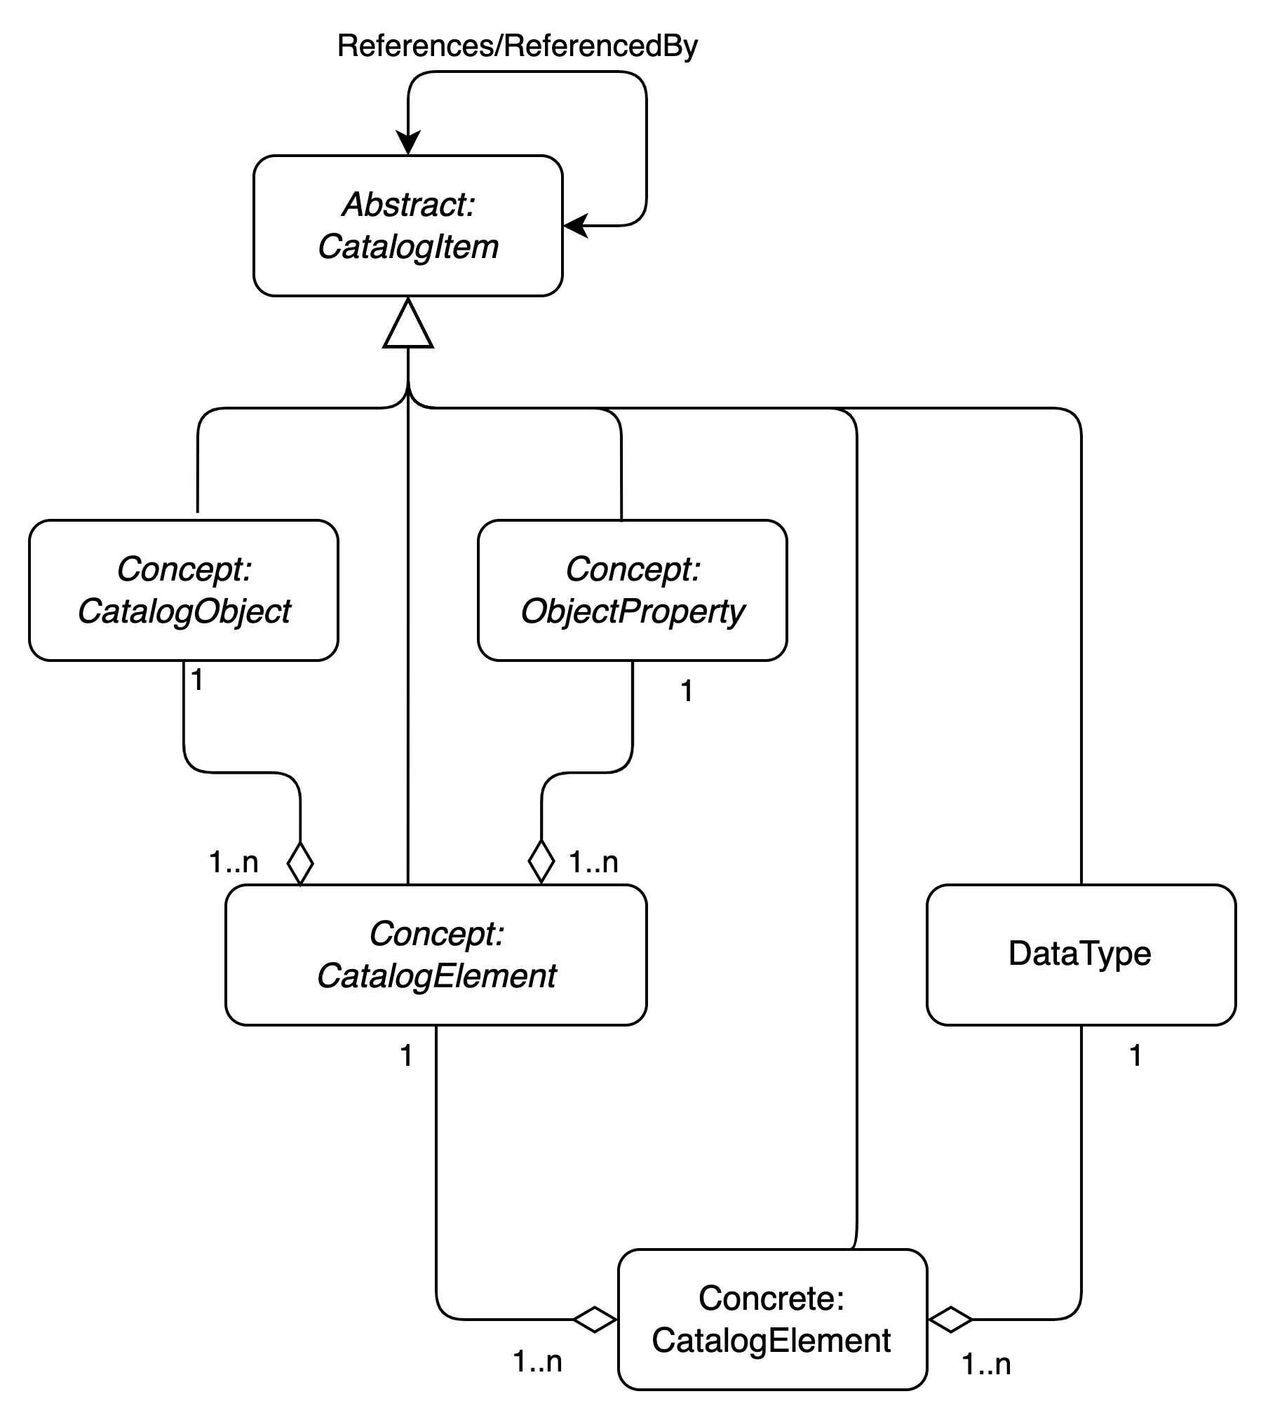
Meta
Metamodel for a Product Catalog ( Structure plus Content )
This model allows to express of all structural components of a catalog including the ones which represent the products shared
It does not define the concrete elements though
This model formalizes/demonstrates the requirement for flexibility/extensibility we look for allowing for bilateral as well as private extensions.

Slide 8
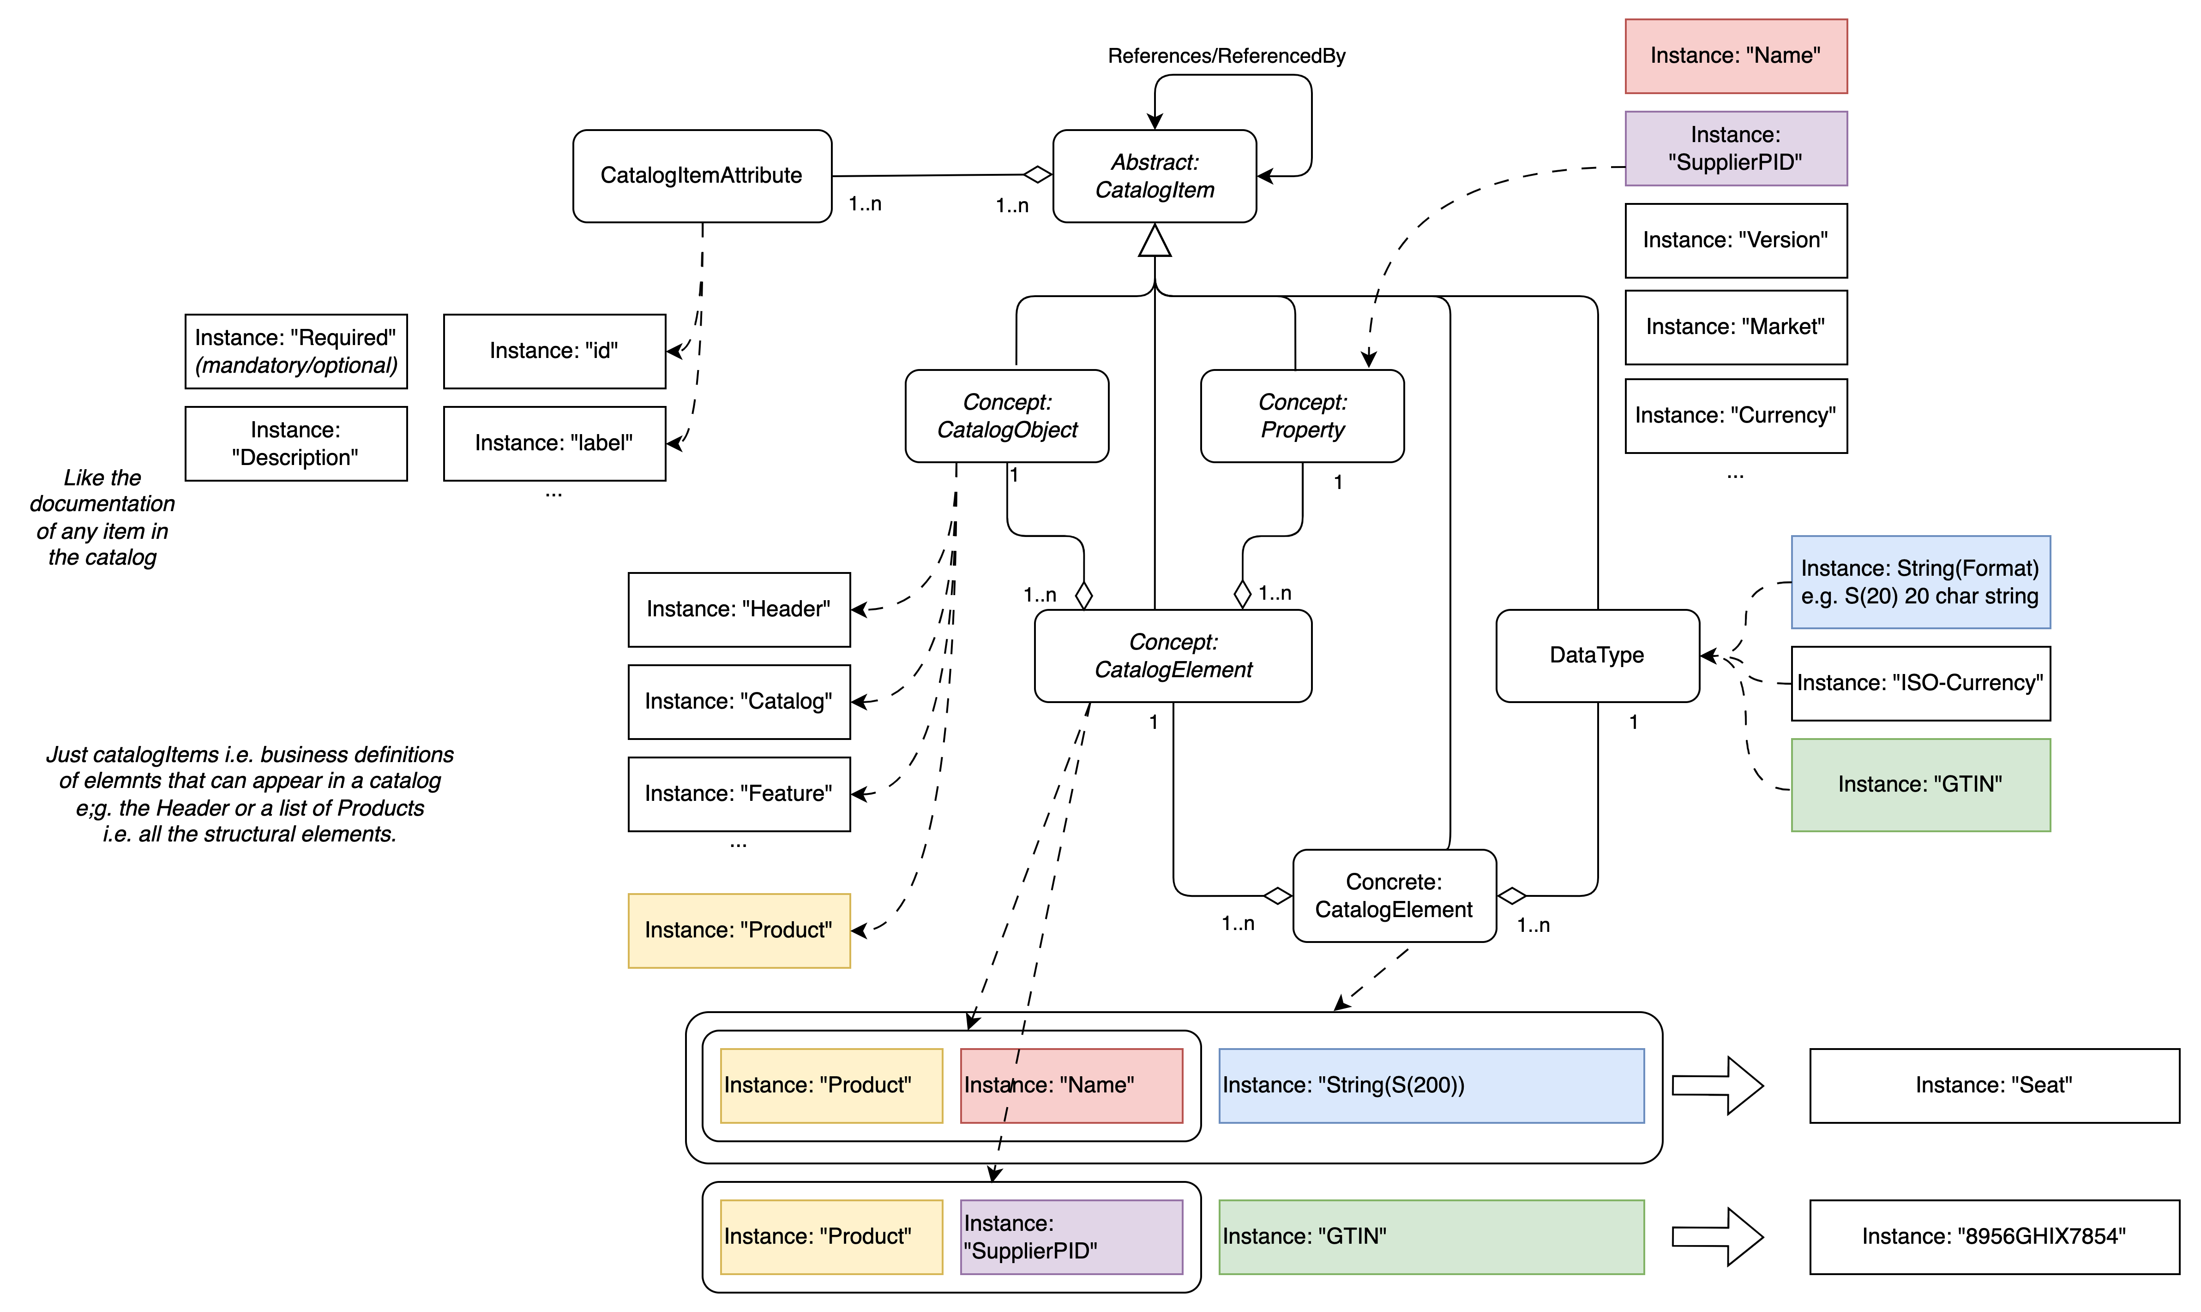
Properties of the Structure Elements
Catalog Structure Elements
Representations of the Structure Elements

Slide 9
Product
Model for a Product
Add the instantiation of the model for a product

Slide 10
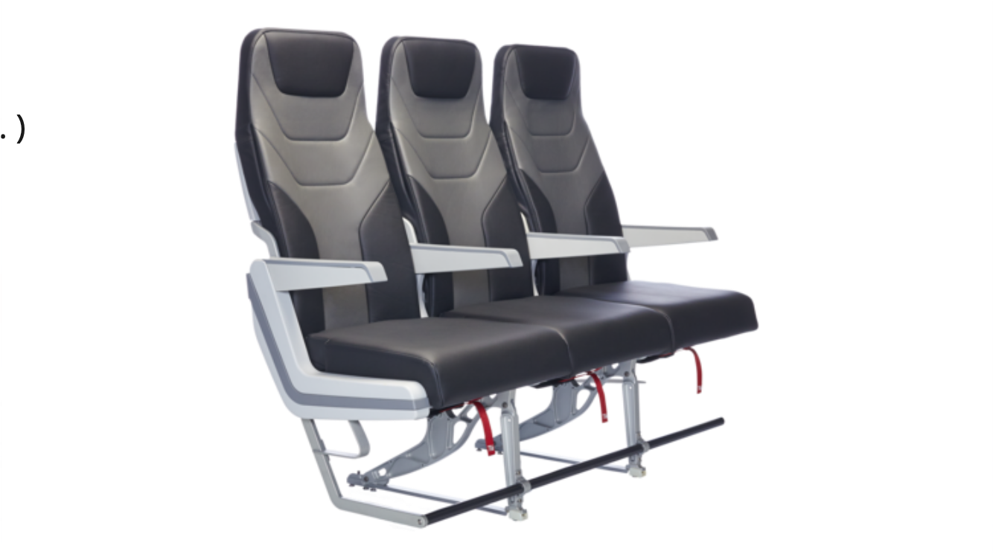
Product: Seat
Add the instantiation of the Product for a Seat

Slide 11
Structural issue at hand
What need’s to be standardized
Content / catalog structure and management ?
Content merge ?
DO WE need to standardize it or just use what’s available

Slide 12
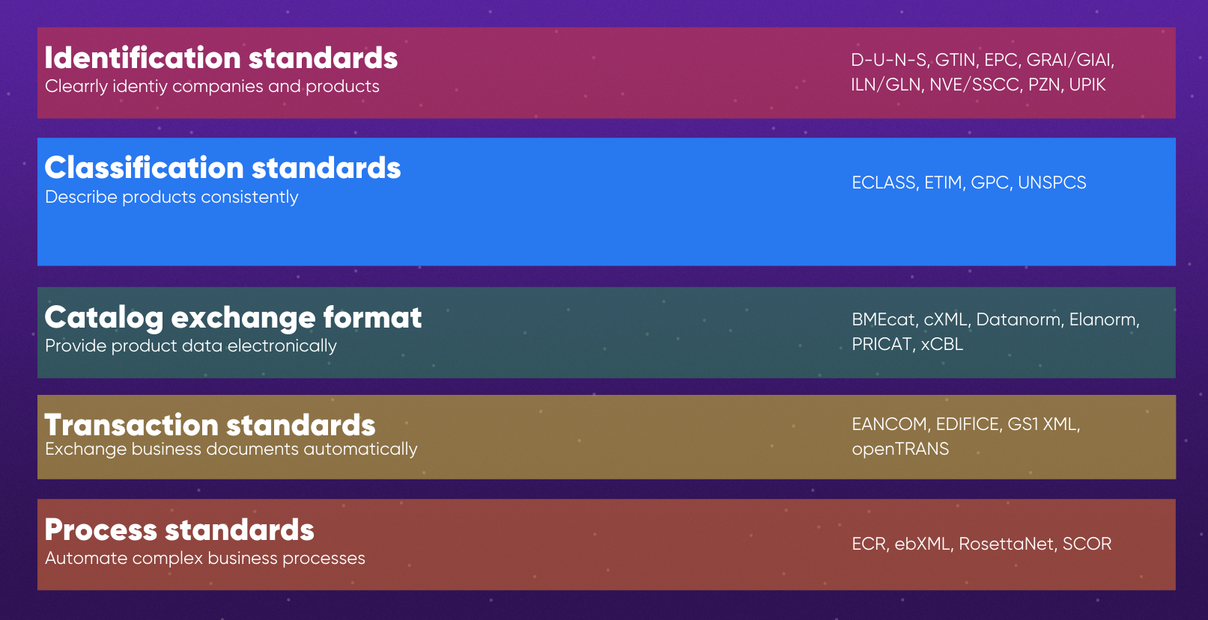
Available eBusiness Standards

Slide 13
Proposal
Ask standardization specialists on this:
ETIM, BMECat, GS1, ISO etc. others
Idea:
Learn and better grasp the do’s / don’ts in this area
Check/Improve on our requirements
Don’t reinvent the wheel if not necessary
Avoid running down dead-end roads

Slide 14
Intro
Proposal
Ask standardization specialists on this
ETIM BMECat etc others
Idea don’t reinvent the wheel and use widely
Objectives
Problem statement
Meta-Meta model ( overall catalog )
Product Meta model ( product )
Seat product
Structural problem ( standards for ebusiness ) …
Issues: separate catalog exchange from the payload ( classification )
Issues: We ca quickly can get lost in the details / run down holes which lead to nowhere

